Slide 1
EE 295
TechWriting-Engineering Ethics
Sep 3, 2019
Room E339
Tom Wrappe
EE Lecturer

Slide 2
Why Study Ethics?
Tech Writing: Formal Reports
In Class Discussion and Exercise

Slide 3
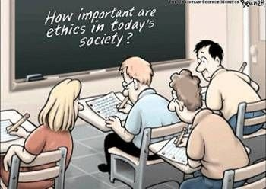
WHY STUDY ENGINEERING ETHICS?

Slide 4
INTRODUCTION
What is Ethics?
Ethics is the study of the characteristics of morals.
Ethics also deals with the moral choices that are made by each person in his or her relationship with other persons.
Engineering ethics is the rules and standards governing the conduct of engineers in their role as professionals.
It encompasses the more general definition of ethics, but applies it more specifically to situations involving engineers in their professional lives.

Slide 5

ETHICS
Study of human morality
Determining values in human conduct
Deciding the “right thing to do” - based upon a set of norms
In Engineering:
dealing with colleagues
dealing with clients
dealing with employees
dealing with “users’
dealing with public

Slide 6

WHY FOCUS ON ETHICS?
Make decisions – make the right choice
Take action – do the right thing
Personal integrity and self-respect
Element of professional reputation
HIGH ETHICS -> HIGH PROFITS

Slide 7
ENGINEERING ETHICS
Engineering ethics is the study of moral values, issues and decisions involved in engineering practice.
The moral values take many forms, including
responsibilities
ideal character traits
social policies
relationships desirable for individuals
corporation engaged in technological development.

Slide 8
ENGINEERING ETHICS
Teaching engineering ethics can achieve at least four desirable outcomes:
increased ethical sensitivity
increased knowledge of relevant standards of conduct
improved ethical judgment
improved ethical will-power (i.e., a greater ability to act ethically when one wants to).

Slide 9
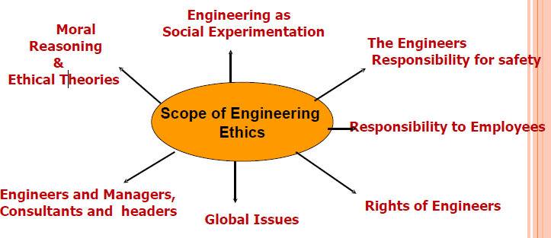
SCOPE OF ENGINEERING ETHICS

Slide 10
ENGINEERING AS AN ETHICAL PROFESSION
What is a Profession?
special expertise
shared moral values
dependent public
self-regulation
promote and protect right actions
The responsibility to be ethical
The right to be ethical
Values embedded in technology

Slide 11

Why Ethics?
Integral part of the success of your career
Integrity can be our most valuable asset,
Leads to trust in work relationships
Frees them from controls necessary when trust doesn’t exist

Slide 12
SO WHY BOTHER WITH ETHICS??
Special knowledge
Involved in decision-making
“Practicing engineers are more apt to get into trouble as a result of a failure to properly anticipate and handle ethical problems rather than as a result of a traditional engineering problems!”

Slide 13
RESULT OF ETHICAL EQUATIONS
ETHICAL BEHAVIOR | UNETHICAL BEHAVIOR
Quality products Conservation of resources Pride in work Public safety Timeliness GOOD BUSINESS | Shoddy products Waste, fraud, greed Abuse of expertise Guilt, fear Lack of safety Cutting corners -poor design -rushed testing DISASTERS!

Slide 14



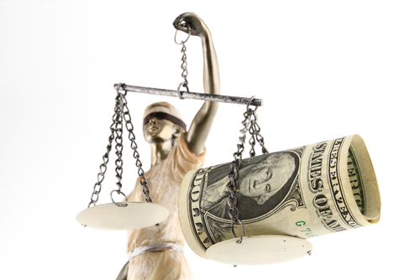


Slide 15
ETHICAL ISSUES FACED BY ENGINEERS
Public Safety
Bribery and Fraud
Environmental Protection
Fairness
Honesty in Research and Testing
Conflicts of Interest

Slide 16
WHY STUDY ENGINEERING ETHICS?
Engineering ethics should be studied because it is important , both in preventing grave consequences of faulty ethical reasoning and in giving meaning to engineers’ endeavors, but it is complex. It cannot be understood through casual observation.

Slide 17
WHY STUDY ENGINEERING ETHICS?
Increased awareness of importance due to publicity surrounding high profile engineering failures.
Engineering decisions can impact public health, safety, business practices and politics.
Engineers should be aware of moral implications as they make decisions in the workplace.

Slide 18
WHY STUDY ENGINEERING ETHICS?
Study of ethics helps engineers develop a moral autonomy.
Ability to think critically and independently about moral issues.
Ability to apply this moral thinking to situations that arise in the course of professional engineering practice.

Slide 19
Video: Volkswagen Ethical Case

Slide 20
Semester Major Items…..(subject to modification)
 | Mid Term | Resume | Final Paper | Final Presentation (slides )
Topic Proposed | 9.12.19 |  | 10.3.19
Topic Final | 9.19.19 |  | 10.10.19
Outline/ Abstract | 9.26.19 |  | 10.31.19
Research | 10.1.19 | 10.24.19 (Class) | 10.15.19
Draft Complete | 10.10.19 |  | 11.7.19 | 11.19.19
Final Submit | 10.22.19 | 11.14.19 | 11.26.19 | 12.3.19
Final Presentation | NA | NA | NA | 12.17.19 (Sect 1) 12.12.19 (Sect 2)

Slide 21
Upcoming Writing Assignments
Engineering versus Scientist paper (9.12.19)
Midterm Topic (9.12.19)
IN CLASS Discussion 9.5.19

Slide 22
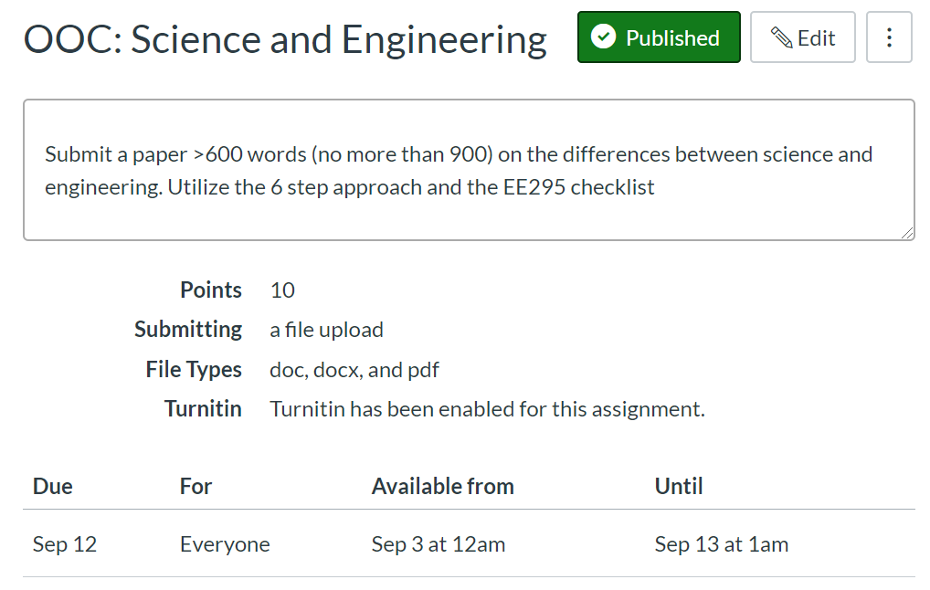

Slide 23
Mechanics and Logistics
Create a Word document for your work (PDF ok, but Word is better going forward)
Upload to Canvas
Turnitin Plagiarism checker should be on and provides a score
Plagiarism score below 15% required or no grade
Latest version will be graded
Grading
Comments will be provided on your submitted document in most cases
Rubric essentially calls for 60% content and 40% grammar

Slide 24
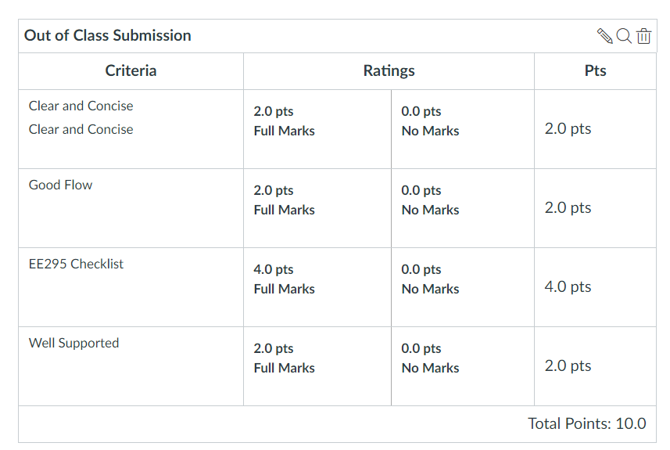

Slide 25
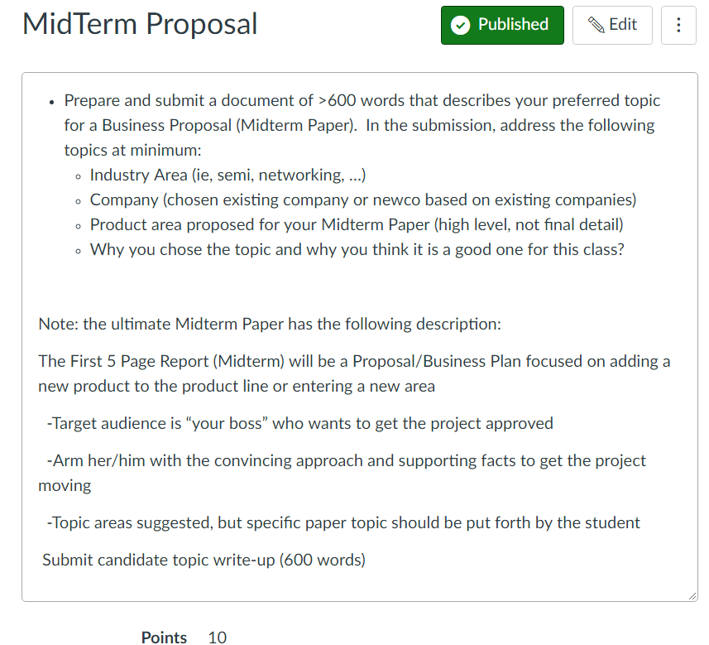

Slide 26
Some Previous Midterm Topics
-Drone navigation system proposal
-AI-based network security system proposal
-On vehicle entertainment network
-Self driving street cleaning trucks
-Wearable sensor system for predicting epileptic seizures
-Brain wave-driven control systems
-Advanced Haptic guidance systems for games and industrial control
-Amphibious drone
-Drone-based taxi system
-Advanced dynamic memory IC’s
-Cryptographic system for IoT
-Forest Fire monitoring system based on IoT

Slide 27
Midterm Key Elements
What is the product?
What is special about the product?
New capabilities
Advances over other products in the area
How does it work?
How do you bring it to the market?
Pick a topic that you know well and that you would like to develop further. OK to pick a topic that may be your Master’s Project

Slide 28
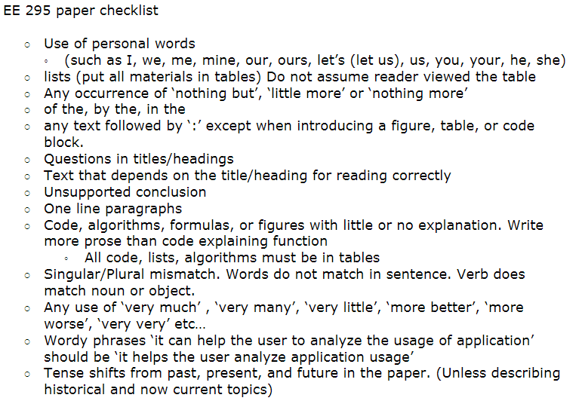
-Morris Jones, EE295 Fall 2016
Minimize use of passive voice. Instead utilize active wording…

Slide 29
Focus on EE295 Items
No personal forms --> I, we, me, us, my, mine, our, ours, you, your, yours, let's (let us), it, etc.
This is a cold heartless IEEE professional document.
Can use 'One' or synonyms when needed
“The data suggests that approach A is the best choice” rather than “I choose approach A”
No 'of the', 'by the', 'in the' ... (Unless required)
Watch excessive use of 'of'
Typically a grammar problem (Word order)
“the measurement of voltage ---> the voltage measurement”
“the professor of the class --> the class professor”
All paragraphs have three sentences minimum:
An introduction or topic (one subject only)
A body or argument
A conclusion

Slide 30
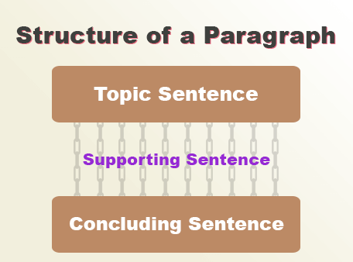
Paragraph
“Students must improve their understanding skill as well as time management skill to get desired scores in the tests. To master each subject and enhance each skill, they must practice old question papers and reference study materials. Additionally, they can practice sample question papers to understand the pertinent exam pattern and marking system. However, to improve their skills, students must follow a strict academic routine.”

Slide 31
Video: 7 Marks of Good Technical Writing

Slide 32
Watch Out List for Tech Writing
Things to avoid

Slide 33

Avoid extra ‘as’
Called as
Named as
Said as
Referenced as
Told as
Describe as
Termed as

Slide 34

Avoid “I won’t tell you” words
Certain
Various
Specific
Obvious
Exigent
Different

Slide 35

Time – terms to avoid (confusing)
Nowadays → currently, at present
In these times → now, currently
In prior times → previously
Before the current → previously
In the current time → now
Brought to light → ?
Come to be → ?

Slide 36
Titles and Headings
Only used to find areas in a document
Never assume they are read
No text should refer to a heading
Watch pronouns
Never have two headings in a row
No ‘-’ or ‘:’ or any combination of the two
No headings in line
Then called a ‘list’

Slide 37
Headings
Should have at least 4 paragraphs per heading
Flow without headings should be good
Never ever ever ever cite a heading

